Slide 1
Classification and Text Analysis of Public Comments to Proposed Rules
Arthur Pignotti
Health Insurance Specialist
Centers for Medicare & Medicaid Services (CMS)
Medicare Plan Payment Group
arthur.pignotti@cms.hhs.gov
INFORMATION NOT RELEASABLE TO THE PUBLIC UNLESS AUTHORIZED BY LAW:
This information has not been publicly disclosed and may be privileged and confidential. It is for internal government use only and must not be disseminated, distributed, or copied to persons not authorized to receive the information. Unauthorized disclosure may result in prosecution to the full extent of the law.
Notes:
Hello, my name is Arthur Pignotti. I’m a health insurance specialist at the Centers for Medicare and Medicaid Services or CMS, working on Medicare Part C and D plan payment policy. My project was to create a process for classifying and analyzing public comments to proposed rules.

Slide 2






Background on Comment Review Process
Post Proposed Rule
Receive Public Comments
Sort & Review Comments
Brief Leadership & Get Decisions
Write & Publish Final Rule
Period can be as short as 30 days
Notes:
First, I’m going to provide some background on the comment review process. For those of you who live and breathe this process, just indulge me for a minute before deciding to fall asleep. First, a proposed rule is posted to regulations.gov. Then, for a specified amount of time, the public can post comments to the proposed rule. These comments can be anything from a one-sentence statement to a 100-plus page document. After the comment period is over, subject matter experts or SMEs sort, review and analyze the comments. Then they brief leadership and get policy decisions. With these decisions, they write and publish the final rule. That does not sound too bad, right? Well, the issue for many of us at CMS is that many of these documents are related to payment and so are bound to payment cycles and timelines. So, in many cases we have as few as 30 days from the end of the comment period to publishing the final rule.

Slide 3


Customer Need: Automate Tasks to Spend More Time on Complex Tasks
Reduce the Time to Sort, Convert, and Read +1,000 Pages of Comments
Quickly Brief Leadership to Maintain Tight Deadlines
Notes:
What are the needs of the stakeholders in this process? In a nutshell, they need the tedious tasks automated so they can spend more time on the complex tasks like analyzing, briefing, and writing. To do this, we need to reduce the amount of time used sorting, converting and reading thousands of pages of comments. Then SMEs can brief leadership sooner, which will help maintain tight schedules and allow for more time to further analyze tougher issues.

Slide 4


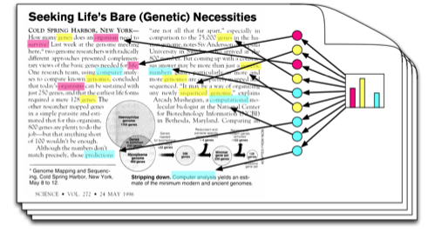
Solution: Topic Modeling Process to Automate Tedious Tasks
Use Proposed Rule Text to Train Topic Model
Automate the Conversion of Comments into Machine Readable Text
Use Topic Model to Classify Public Comments by Proposed Rule Section
Notes:
A solution to these problems is creating a topic modeling process to automate tedious tasks like classifying and converting comments. The first step in this process is to use the text from the proposed rule to train a topic model. Next, a program automates the conversion of comments into machine readable text that the topic model can use. Then the model classifies comments by assigning them match probabilities for each section of the proposed rule.

Slide 5
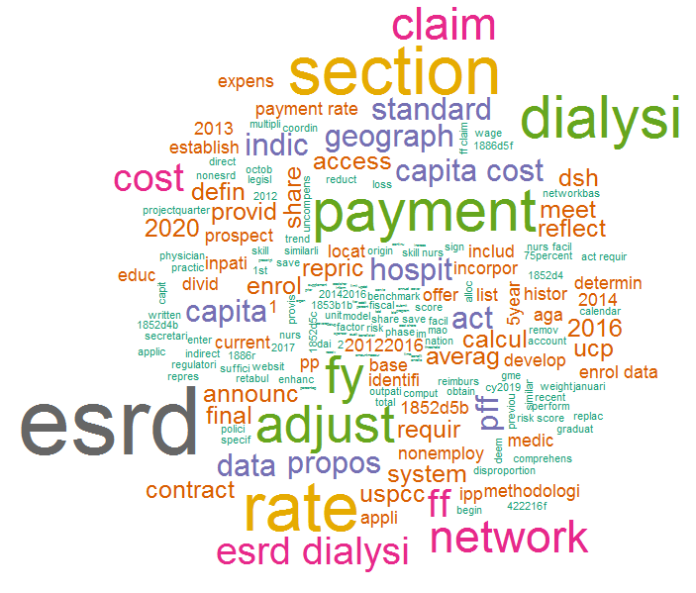
What is a Topic Model
Example Topic: ESRD Rates
Notes:
Let’s take a quick step back. What is a topic model? A topic modeling algorithm basically builds a model by grouping significant, correlated words together into topics. If that did not make sense, here is a concrete example on the left. Say we have a section about ESRD rates. In the section, words like ESRD and dialysis appear often and uniquely since other sections will most likely not use these words. Therefore, among the topics that the model creates, there should be one where these words are heavily weighted. The graphic on the right illustrates the comment classification process. Imagine that this is a comment and each color represents a topic. The model searches the comment for instances of terms from different topics. Each time a word from a topic appears, the probability that the comment matches that topic increases until we have final probability scores.

Slide 6
Example Output
Comment ID | Text | Link | Section A | Section B | Section C | Section D | Section E
Rule#-0001-0-1 | Lorem ipsu… | C:\Comm… | 0% | 0% | 2% | 0% | 18%
Rule#-0002-0-1 | dolor sit… | C:\Comm… | 0% | 0% | 100% | 0% | 0%
Rule#-0003-0-1 | amet, muc… | C:\Comm… | 0% | 75% | 0% | 0% | 92%
Rule#-0003-1-1 | copiosae pr… | C:\Comm… | 0% | 0% | 0% | 0% | 0%
Rule#-0004-0-1 | an, eos mei… | C:\Comm… | 0% | 0% | 0% | 0% | 0%
Rule#-0004-1-1 | sensibus te… | C:\Comm… | 98% | 0% | 0% | 92% | 0%
Rule#-0004-1-2 | Et quem… | C:\Comm… | 0% | 0% | 95% | 0% | 0%
Rule#-0004-1-3 | omittantur… | C:\Comm… | 0% | 0% | 0% | 4% | 0%
Rule#-0004-1-4 | liberavisse… | C:\Comm… | 0% | 0% | 0% | 97% | 0%
Rule#-0004-1-5 | Nihil dicant… | C:\Comm… | 2% | 84% | 0% | 0% | 88%
Rule#-0004-1-6 | cetero an… | C:\Comm… | 0% | 0% | 0% | 0% | 0%
Rule#-0004-1-7 | nam, liber… | C:\Comm… | 0% | 0% | 0% | 0% | 0%
Rule#-0004-1-8 | Nonumy lab… | C:\Comm… | 0% | 0% | 0% | 0% | 95%
Notes:
Here is an example of the output that SMEs would receive. It has the comment ID, the text from the comment, a link to the comment and a column for each section of the proposed rule with scores that represent the probability that the comment discusses a section. If the model is working well, most scores should be either near 0 or 100%. Now, SMEs can sort the document by their section’s results and work their way through the list in order of relevance.

Slide 7
Benefits for Stakeholders
Automate tedious tasks = more time for important tasks
Briefing sooner = earlier decisions
More time to analyze tougher decision points
Identify write-in campaigns and duplicate submissions
Notes:
This process creates a number of benefits for stakeholders. The process automates tedious tasks so we can allocate more time to important tasks. The time savings of the classification process will allow SMEs to brief sooner, meaning earlier decisions and maintenance of tight deadlines. Quicker decisions will allow for more time to do in-depth analyses on tougher decision points. A feature that I have not mentioned yet, which is a also benefit, is we can identify write-in campaigns and duplicate submissions, which can, at times, consolidate hundreds of comments.

Slide 8
Next Steps
Systematically test accuracy
Add ability to edit term weights using SMEs’ expertise
Outputs from the process can be used as inputs
Comment count estimates by topic
Possible sentiment analysis
Notes:
Finally, next steps. I need to test the accuracy of my test models. I have eyeballed accuracy, but have not systematically calculated an overall accuracy score. I’m also working on a way to use SME’s input to edit term weights in the model to strengthen its robustness. Finally, the outputs from this process can be used as inputs of other types of analysis, ranging from simple comment count estimates by topic to complex sentiment analysis of industry reactions to particular sections. Now, if some of that sounded like gobbledygook feel free to stop by my board later today to ask questions.

